Slide 1
An advance algorithm for a new virtual assistance: What is it?
Student: Do Dung Vu
Supervised by: Prof. Sylvie Ratté and Dr. Ronald Brisebois

Slide 2
Outline
Motivation
Artificial intelligence (AI) forecast
AI virtual assistance
Literature review
Challenges
Objectives
Methodology
Study Plan
Question

Slide 3
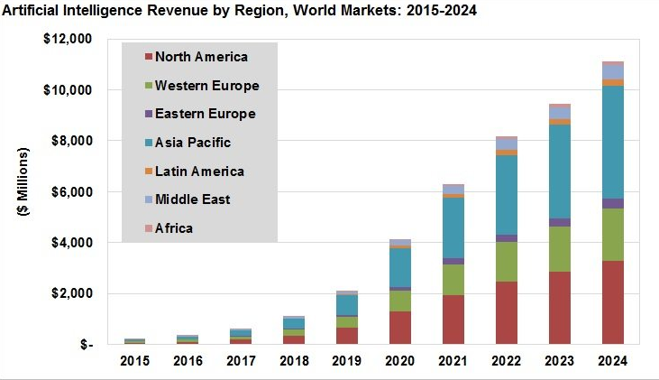
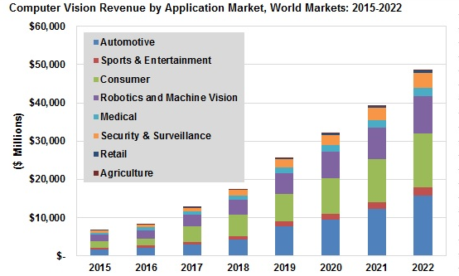
Artificial intelligence (AI) forecast
Source: Tractica

Slide 4

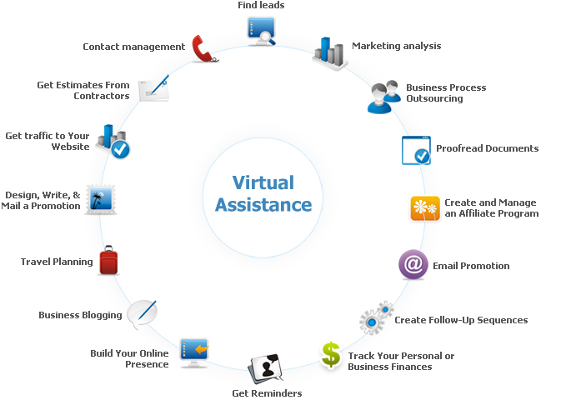

AI virtual assistants
- Could you explain and show me more information of the new items which I have not seen yet?
Source: http://www.cogniview.com

Slide 5
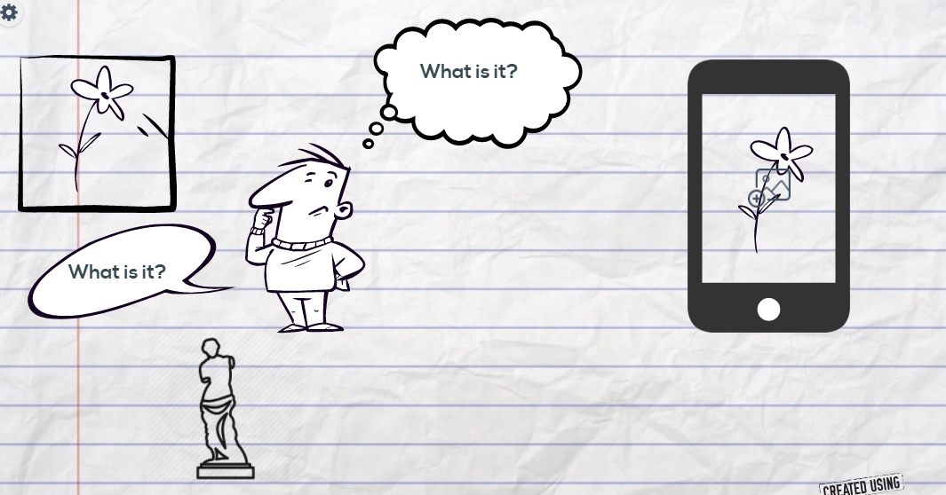








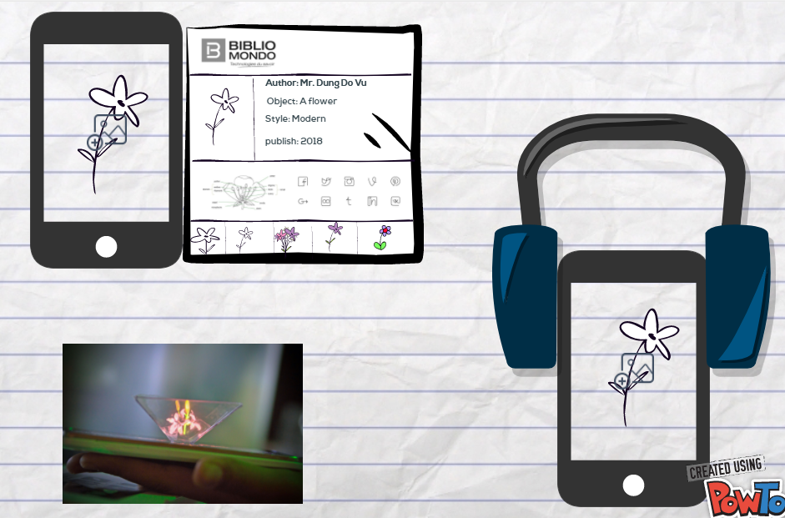

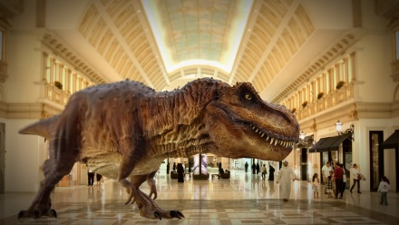
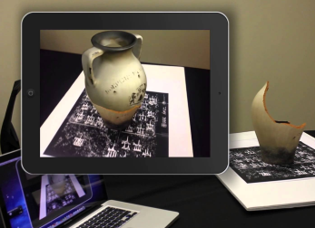
Problem?
VIRTUAL REALITY
hologram
AUGMENTED REALITY

Slide 6
Literature review
Content based image retrieval (CBIR) is an important research area for manipulating large multimedia databases and digital library characterized by automatic indexing of images based on their own visual features, CBIR uses featured include [1] color, texture, shape, and edge information
The features were classified using the random forest classifier and provided 74.7% accuracy for the RGB data[2]. Spare coding [3] and clustering based convolutional extractors [4],[5] have increased the classification performance to 85.2%
The visualizations in [6][7] indicates that, as the distribution of objects is transformed from overlapped space to separable space in a deep network, intermediate representations can be used as generic features to semantically describe the object in the input image

Slide 7
Literature review
CBIR used multiple support vector machine (SVM)’s ensemble method narrow down search space and handle the large image database [8]
Extracting low-level features (color, texture, edge density) and measuring distances to find the similarity between images in reducing the semantic gap between the low level features and the high level semantic concept [9][10]

Slide 8
Literature review
[1] Naresh Babu, Pothlaiah, and Ashok Babu, “Image Retieval Color, Shape, and Texture Features using Content Based”, International Journal of Engineering Science and Technology, Vol. 2, No. 9, pp. 4278-4287, 2010
[2] K. Lai, L. Bo, X. Ren, and D. Fox, “A lage-scale hierarchical mulit-view RBG-D object dataset”, in Proc, IEEE Int. Conf. Robot. Autom. (ICRA), May 2011, pp. 1817-1824
[3] L. Bo X. Ren, and D. Fox, “Unsupervised feature learning for RBG-D based object recognition”, in Experimental Robotics, Springer, 2013, pp. 387-402
[4] R. Socher, B. Huval, B. Bath, C. D. Manning, and A. Y. Ng, “Convolutional-recursive deep learning for 3D object classification”, in Proc, Adv. Neural Inf. Process. Syst., 2012, pp. 665-673
[5] Y. Cheng, X. Xhao, K. Huang, and T. Tan, “Semi-supervised learning and feature evaluation for RGB-D object recognition”, Comput. Vis. Image Understand, vol. 139, pp. 149-160, Oct, 2015
[6] J.Donahue et al. (2013). DeCAF: A deep convolutional activation feature for generic visual recognition”, [Online]
[7] M. D. Zeiler and R. Fergus, “Visualizing and understanding convolutional networks”, in Computer Vision – ECCV. Springer, 2014, pp. 818-833
[8] A. Shitole and U. Godase, “Survey on Content Based Images Retrieval”, in International Journal of Computer-Aided Technologies (IJCAx) Vol.1, No.1, 2014, pp. 21-29
[9] S. Tunga, D. Jayadevappa, and C. Gururaj, “A Comparative Study of Content Based Image Retrieval Trends and Approaches”, in International Journal of Image Processing (IJIP), Vol. 9: Issue 3, 2015, pp. 127–155.
[10] D. Pandey and S. Kushwah, “ A Review on CBIR with its Advantages and Disadvantages for Low-level Features”, in International Journal of Computer Sciences and Engineering, Vol : Issue 7, 2016, pp. 161- 167

Slide 9

Original feature information:
+ Color
+ Texture
+ Shape
+ Spatial Location
+ Local image
Source: https://uqr.me/blog/qr-codes-in-museums/

Slide 10
Challenges
Identify and recognize the object with the “private feature” of artwork, specimen, whatever
Faster handling of responding for real time used cases
Data authenticity, confidentiality, ready, and integrity for real time applications
The expectation of users for huge amount of objects to search among
Sometimes incompleteness query specification seems to be a challenge
Incomplete image description is also a source of challenge to an efficient CBIR system
The issue related to the semantic gap where it means the lack of coincidence between information that the same data have for a user in a given situation
Updating meta-data based on the collected information from each node ( user)

Slide 11
Original feature information:
+ Color
+ Texture
+ Shape
+ Spatial Location
+ Local image
Proposed advantage features:
+ private features
+ style features
+ guessing features
QR codes information:
+ ID of the items in the museum
Geo-tag information:
+ geolocation
+ hashtag information

Slide 12
Objectives
Enhance privacy virtual assistance in Library and Museum
Improve the accuracy and performance of object recognizing to detect the “private feature” of each artwork, specimen in the museum, or person, car, furniture, the original of items, etc.,
Design automatically category mechanism for object recognition, and application development as well as for detecting “private feature” of each artwork and specimen
Develop algorithms and applications based on the given metadata of the library, museum, or open data

Slide 13
Methodology
Exploit the Artificial, Deep, Recurrent, Convolutional neural networks (ANN,DNN, RNN,CNN), Supervised, Unsupervised, and Deep reinforcement learning, search engine algorithm to improve the quality of object recognition.
Build-up machine learning algorithms and artificial intelligence in order to recognize, analyze and make the explanation of a given object by using smartphone camera.
Make the approximated verification method to confirm the accuracy of generated information
Update the knowledge of the system based on the users’ contributions

Slide 14








My phone 1
Museum 1
Bibliomondo
Museum 1
CLIENT
Detect and recognize object :
+ Recommendation system
+ Machine learning
+ Artificial Intelligence
+ Search engine algorithm
Verification:
+ Geo-location of the item
+ Bar-code of the item
User contribution:
+ User may catelogy manual
+ Vote the responded information
- Updated
------------------------------------
SERVER
+ Recommendation system
+ Reinforcement Learning
+ Machine learning
+ Artificial Intelligence
+ Search engine algorithm
Internet
Museum n
My phone n
Museum n

Slide 15
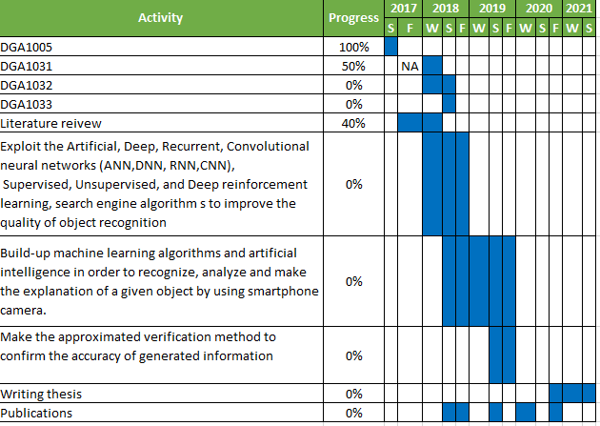
Study plan

